Slide 1

Folihub
E-portfolio Protocol
presented by Team 11

Slide 2
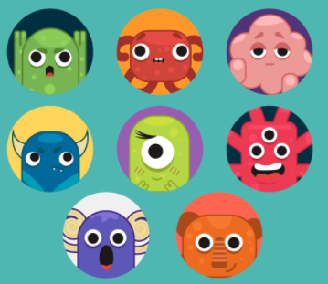
About Us
Product Owner
Frontend Developer
Scrum Master
Frontend Developer
Yunwei Wu
Yifei Zhu
Haoyang Yu
Danlai Mou
Ruijie Pan
Backend Developer
Frontend Developer
Backend Developer
Backend Developer

Slide 3

Clients and Requirements
We want to have a strong authentication system, so the user’s information is secured.
Clients
No Problem!
We gonna use passport js for authentication.

Slide 4
Clients and Requirements
We also want to have a fully customized online editing function.
Clients
Of course!
We gonna use a rich text editor quill js for editing portfolio.

Slide 5
Clients and Requirements
And...we want to allow our users to share eportfolios both online and offline!
Clients
Sure!
We gonna use PDF Make to achieve offline sharing.

Slide 6


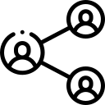
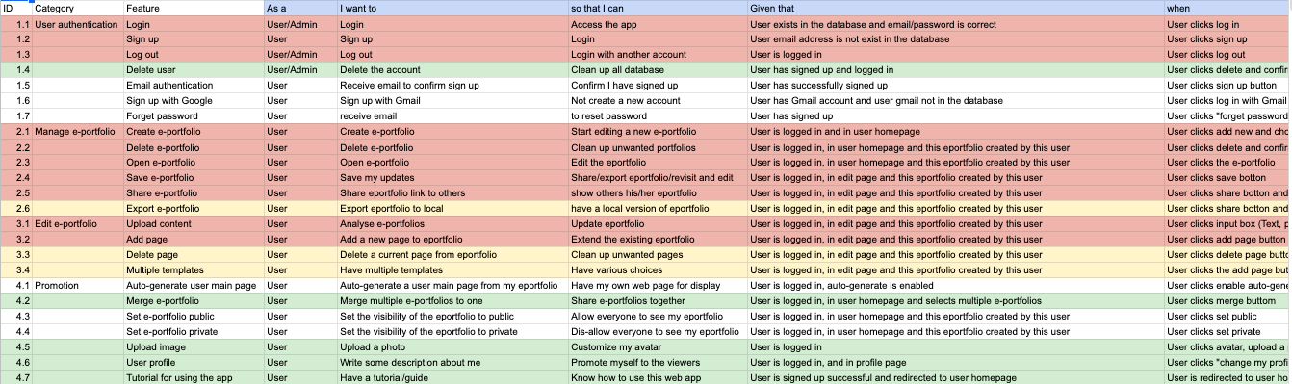
Clients and Requirements
Authentication
Online Edit
Online Preview/ Share
Notes:
https://docs.google.com/spreadsheets/d/1bjDjQpugDNJr6GAIekOqHeGGtIGbxu04kVXI_TewePs/edit#gid=0

Slide 7






Technologies Used
Front-end Server
Back-end Server
Database
React js
Node js
React DOM
Axios
Passport js
CORS
Front-end Server
(View)
Back-end Server
(Controller)
Database
(Model)
Material UI
SQL js
Session
PDF Make
mySQL
(Google Cloud)
(PaaS)
Bcrypt js
...
Quill js
...

Slide 8

Technologies Used
Testing
Deployment
Mocha
Chai
folihub
folihub-api
Front-end Server
(View)
Back-end Server
(Controller)
Database
(Model)
Front-end Server
(View)
AJAX
Back-end Server
(Controller)
Database
(Model)
HTTPS

Slide 9
Technologies Used
Testing
Deployment
Mocha
Chai
folihub
folihub-api
Front-end Server
Back-end Server
Database
React js
Node js
React DOM
Axios
Passport js
CORS
AJAX
Material UI
PDF Make
HTTPS
Session
SQL js
mySQL
(Google Cloud)
Quill js
...
Bcrypt js
...

Slide 10






Collaboration Tools
Project Management
Code Repository
Documentations
Communication

Slide 11

Product Demonstration
Access our website!
https://folihub.herokuapp.com/
Access the demo e-portfolio!
--It may takes a few moments to load the page when it is the first time accessing it
https://folihub.herokuapp.com/exportfolio/1

Slide 12



Key Challenges
Developing
Deploying
Vertically
Planning
Horizontally
Communicational Challenges
Technical Challenges
Notes:
Besides communication challenges, our team also faced some technical challenges.
during planning stage: not very experienced in developing web product → hard for us to decide which tool to use; structures and code design could be problematic and requires reimplement.
during developing stage: vertical communicational challenges → merging code on Github; branch protection and code review process required some time for us to get used to
during deploying stage: two separated servers are used, need to solve unexpected integration errors such as CORs policy

Slide 13


Lessons Learned
Do Tasks For Purposes
Documentation and Communication
Group Working and Specialization
Task 1
Functionality
Trello
User Stories
Group working and specialization are both important in a group project.
Documentations
Task 2
Do Tasks For Purposes
Documentation and Communication
Group Working
code review
(code quality, conflicts, vulneralbilities)
...
Sometimes documentations are better than talking directly
deploy
develop/
maintainence
Each action needs to be meaningful, and contributes to the accomplishment of the product.
Notes:
First of all, we understood that during development we need to do tasks for purposes.
sprint 1: tasks was directly based on main functionalities → general and unclear
later, we changed it to based on user stories → acceptance criteria of each tasks is highlighted
What’s more, we noticed that sometimes communicating with documentations is better then talking.
front-end developers requires an api from back-end developers: more efficient to have api documentations
documentations also good for keeping records and easier for moving on to future maintainence
Last but not least, despite we are woring as a team in this project, group working and specialization are both important.
sprint planning: functionalities are distributed to each developer → in charge of developing and maintaining this
code review: group work involved, which requires team members to truct on each other to make the code works properly
although we are a team, working individually sometimes is more benefitial.

Slide 14
